Slide 1
Natural Language Processing Specialization Machine Translation and Document Search
(2020 Deeplearning.ai)
YangXi’s Reading Notes

Slide 2
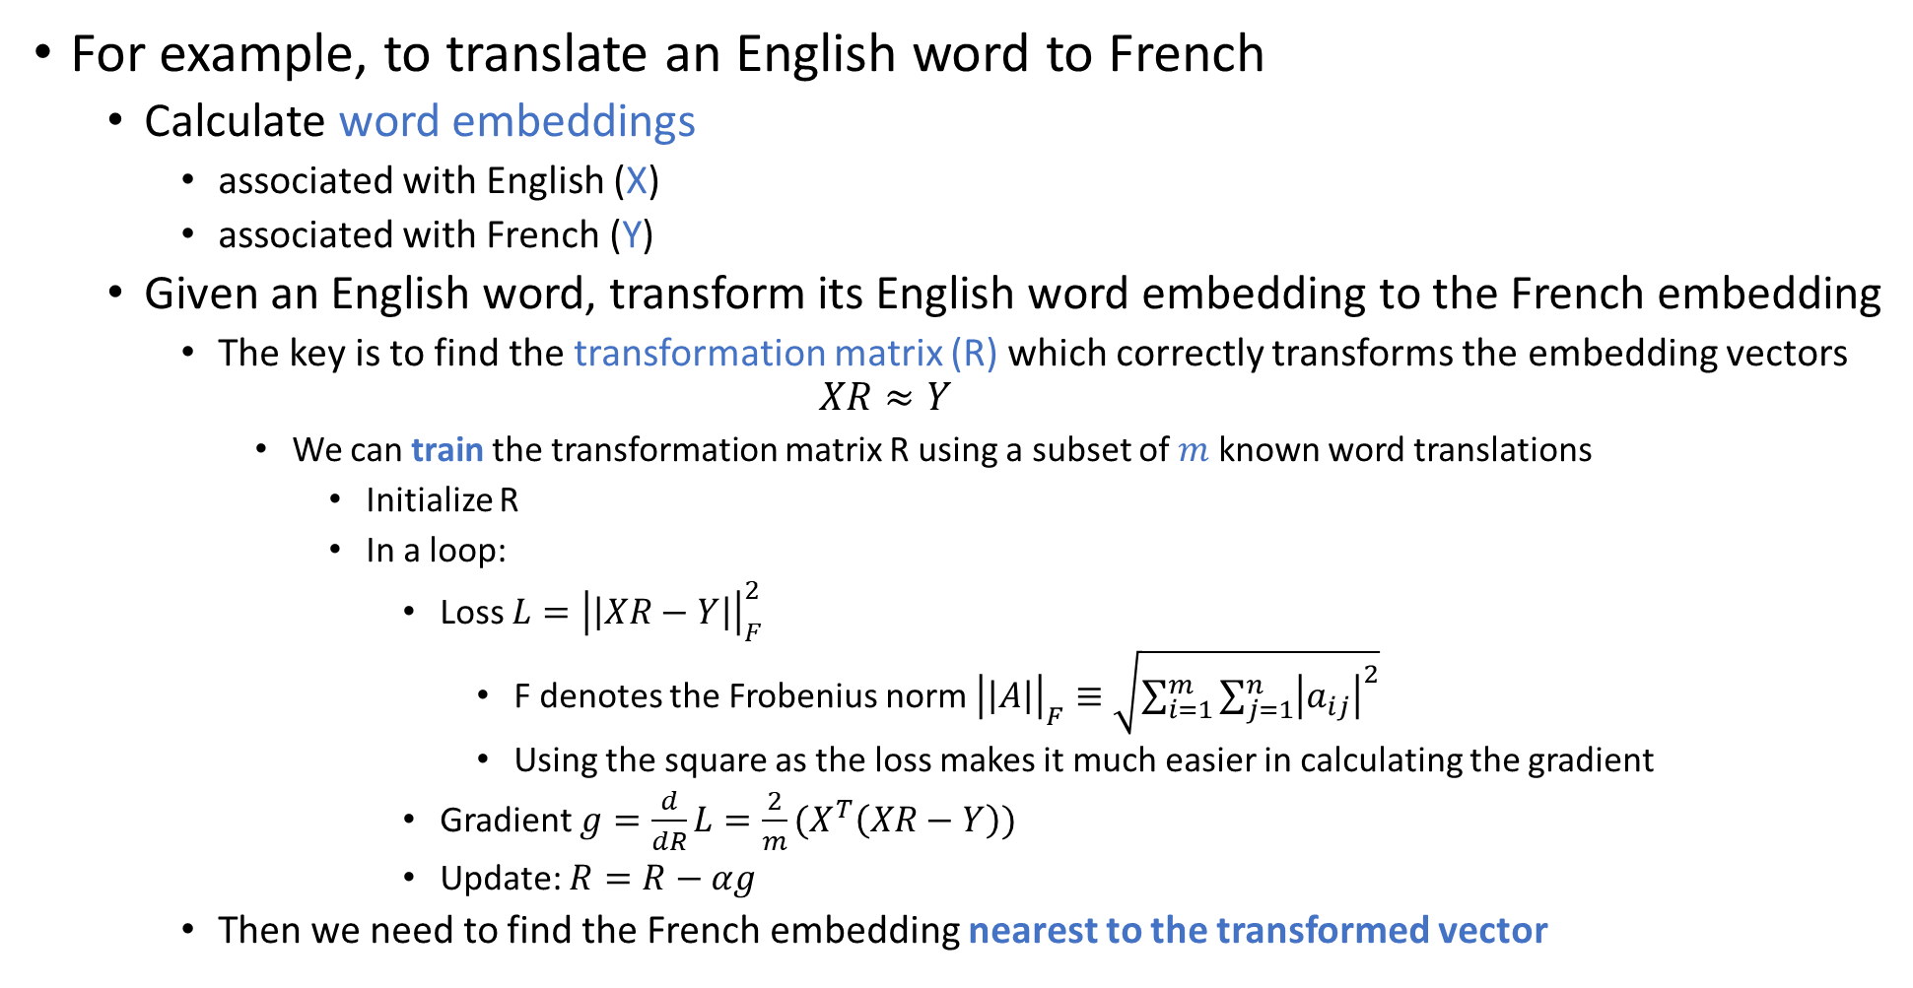
Translation with Word Embeddings
For example, to translate an English word to French
Calculate word embeddings
associated with English (X)
associated with French (Y)
Given an English word, transform its English word embedding to the French embedding
The key is to find the transformation matrix (R) which correctly transforms the embedding vectors $XR≈Y$
We can train the transformation matrix R using a subset of $m$ known word translations
Initialize R
In a loop:
Loss $L={\left|\left|XR−Y\right|\right|}_{F}^{2}$
F denotes the Frobenius norm${\left|\left|A\right|\right|}_{F}≡\sqrt{\sum_{i=1}^{m}{\sum_{j=1}^{n}{{\left|a_{ij}\right|}^{2}}}}$
Using the square as the loss makes it much easier in calculating the gradient
Gradient $g=\frac{d}{dR}L=\frac{2}{m}(X^{T}\left(XR−Y\right))$
Update: $R=R−αg$
Then we need to find the French embedding nearest to the transformed vector

Slide 3
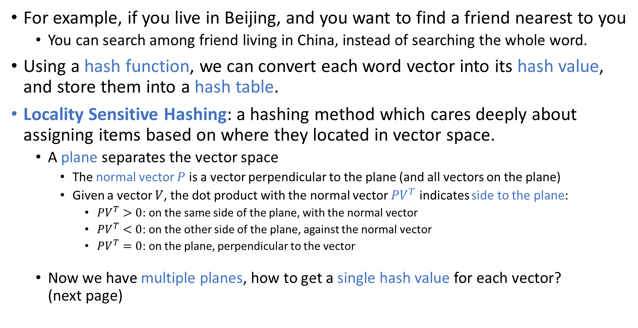
K-Nearest Neighbors with Locality Sensitive Hashing
For example, if you live in Beijing, and you want to find a friend nearest to you
You can search among friend living in China, instead of searching the whole word.
Using a hash function, we can convert each word vector into its hash value, and store them into a hash table.
Locality Sensitive Hashing: a hashing method which cares deeply about assigning items based on where they located in vector space.
A plane separates the vector space
The normal vector $P$ is a vector perpendicular to the plane (and all vectors on the plane)
Given a vector $V$, the dot product with the normal vector $PV^{T}$ indicates side to the plane:
$PV^{T}>0$: on the same side of the plane, with the normal vector
$PV^{T}<0$: on the other side of the plane, against the normal vector
$PV^{T}=0$: on the plane, perpendicular to the vector
Now we have multiple planes, how to get a single hash value for each vector? (next page)

Slide 4
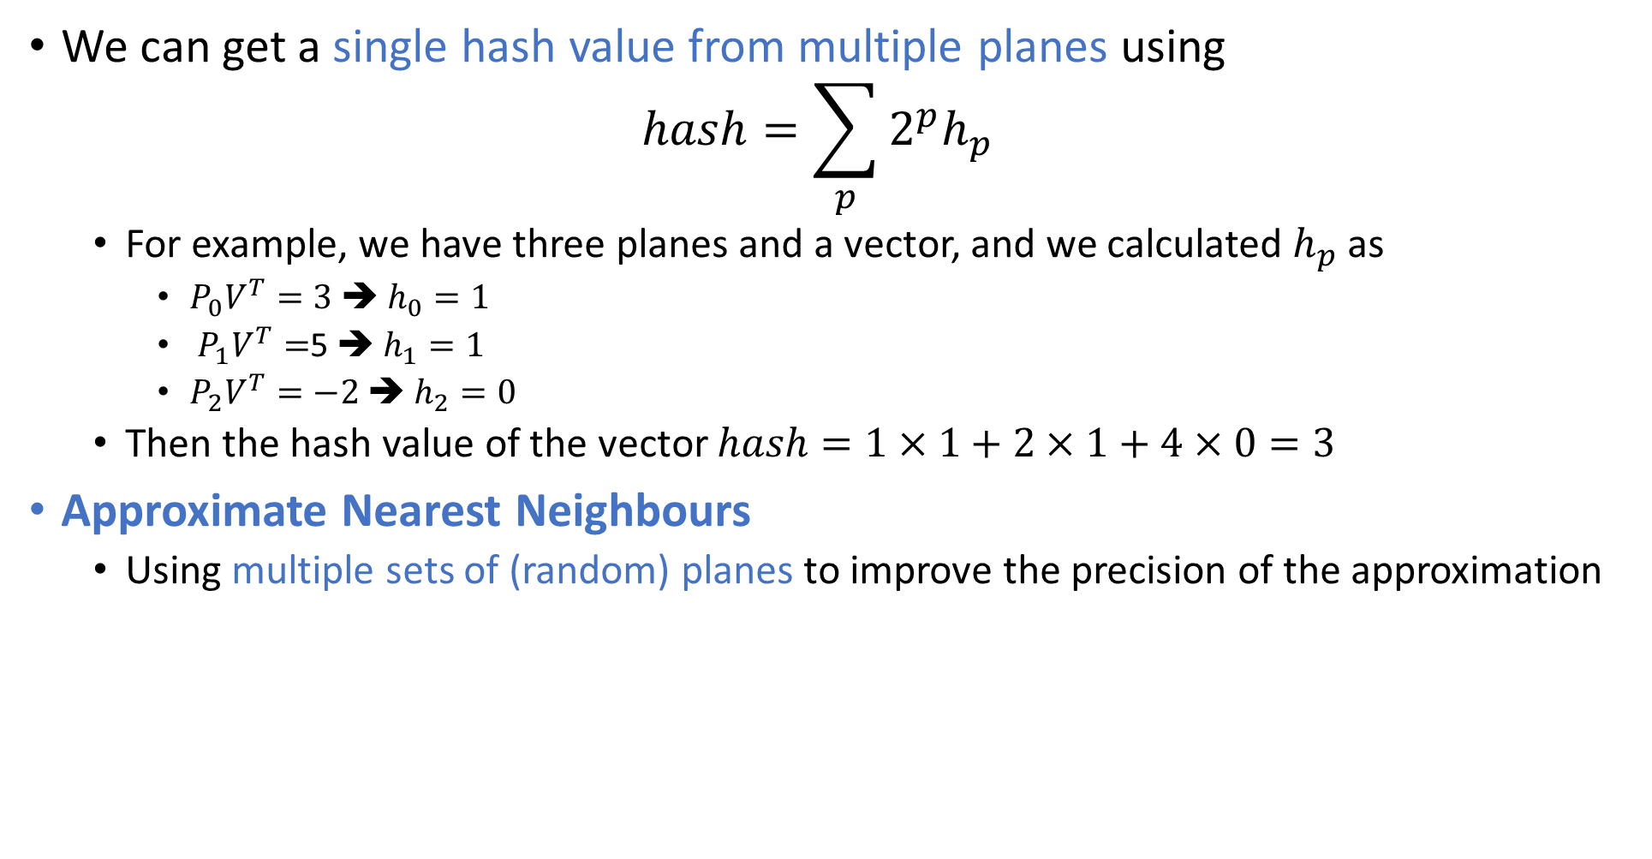
Single Hash Value from Multiple Planes
We can get a single hash value from multiple planes using $hash=\sum_{p}{2^{p}h_{p}}$
For example, we have three planes and a vector, and we calculated $h_{p}$ as
$P_{0}V^{T}=3$ ➔ $h_{0}=1$
$P_{1}V^{T}=$5 ➔ $h_{1}=1$
$P_{2}V^{T}=−2$ ➔ $h_{2}=0$
Then the hash value of the vector $hash=1×1+2×1+4×0=3$
Approximate Nearest Neighbours
Using multiple sets of (random) planes to improve the precision of the approximation

